Slide 1
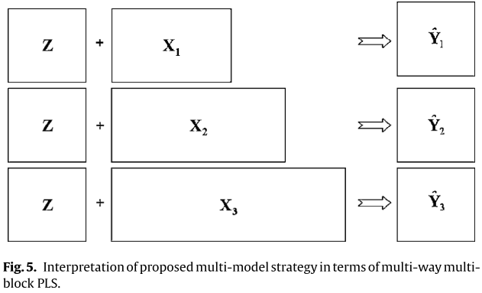
decision points
k1
k2
k3
Initial conditions
online measurements
Quality prediction

Slide 2
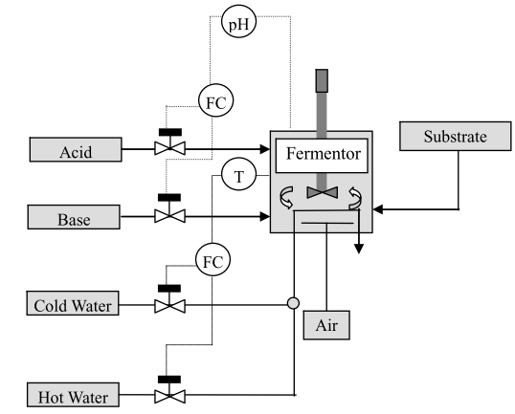
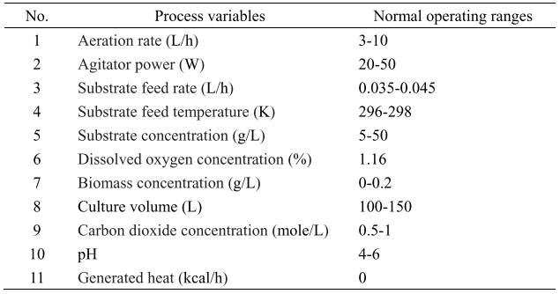
Data Generation
Offline Modelling and Prediction
Offline Modelling and Prediction
Pre-Processing
Phase Assignment
Dynamic Time Warping (DTW) / Indicator Variable (IV) trajectory alignment
Online New Sample
3D batch data Unfolding (variable-wise) to 2D and normalization
Calculate posterior probability to identify phase
Fed-batch Penicillin Process
Remove collinearity and reduce dimension of input variables using PCA
Steady Phase
Fuzzy Phase
Phase Detection
K-means and DBScan on latent variables to determine initial guess for GMM clusters
Quality Prediction
Invoke Local Model to predict final quality
Bayesian Model Averaging for adjacent local models
Identify operating phases intervals
Estimate GMM, incorporating AIC/BIC
Inherently multiphase & nonlinear
Variations in initial conditions
Noise on certain signals (O2, CO2)
Time delays in quality measurements (Z.O.H)
Variation in timing of key sequences (S = 0.3g/ mol)
Variations in batch lengths (P >= 1.3 g/ mol)
Obtain output quality predictions
Identify transition phases as overlap between Gaussians
Local Model Development
Evaluate Performance
Collect training data
50 normal batches, 3-5 non-optimal batches, 1 ‘golden’ reference batch
Develop local GPR models to predict final quality variable

